Slide 1
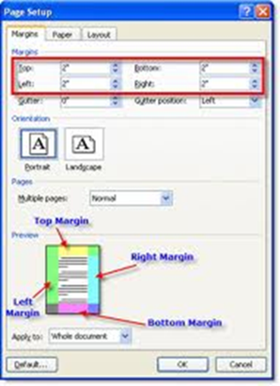
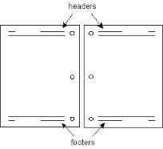
Margins
Headers and Footers

Slide 2

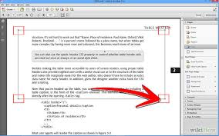
Margins in Word 2010

Slide 3
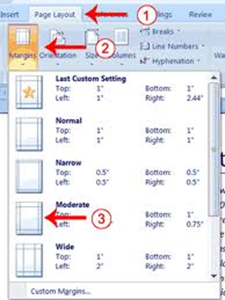
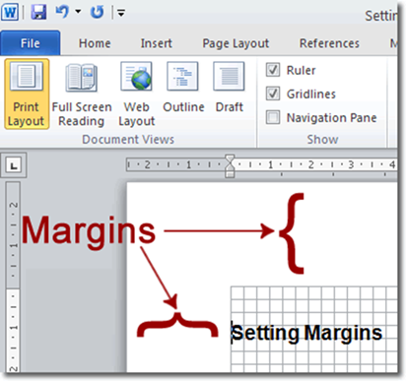
Setting Margins
Setting Margins
Click Page Layout >Margins > Custom Margins
Or you can choose those that are pre-set
Custom Margins allows you to define your own margin widths

Slide 4

Note : Settings should be in centimeters (cm). This will be the case if you have centimeters as the default unit in Word

Slide 5
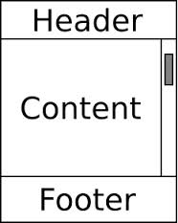
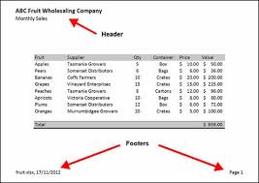
Headers and Footers :

Slide 6
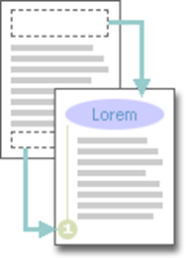
Headers and footers are areas in the top, bottom, and side margins of each page in a document.

Slide 7

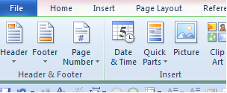
You can add file name , page numbers name of Authors in your header or footer .

Slide 8
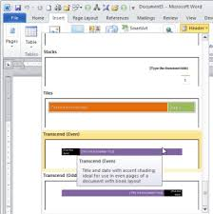
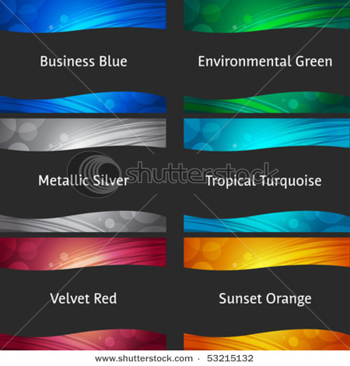
Stylish Headers and Footers
.

Slide 9
Inserting Headers and Footers

Slide 10

Activity
Learner’s worksheet in DataFiles_Solutions Folder
Activities in prescribed books

